Slide 1



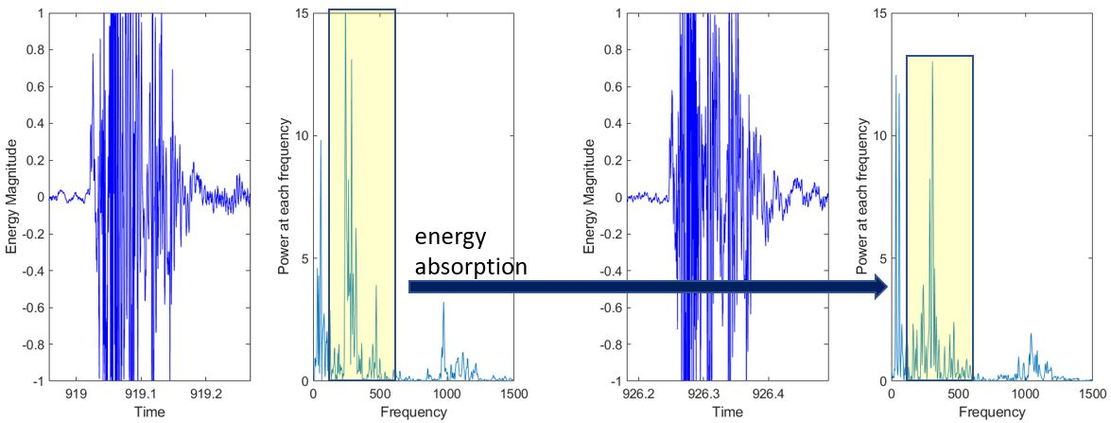
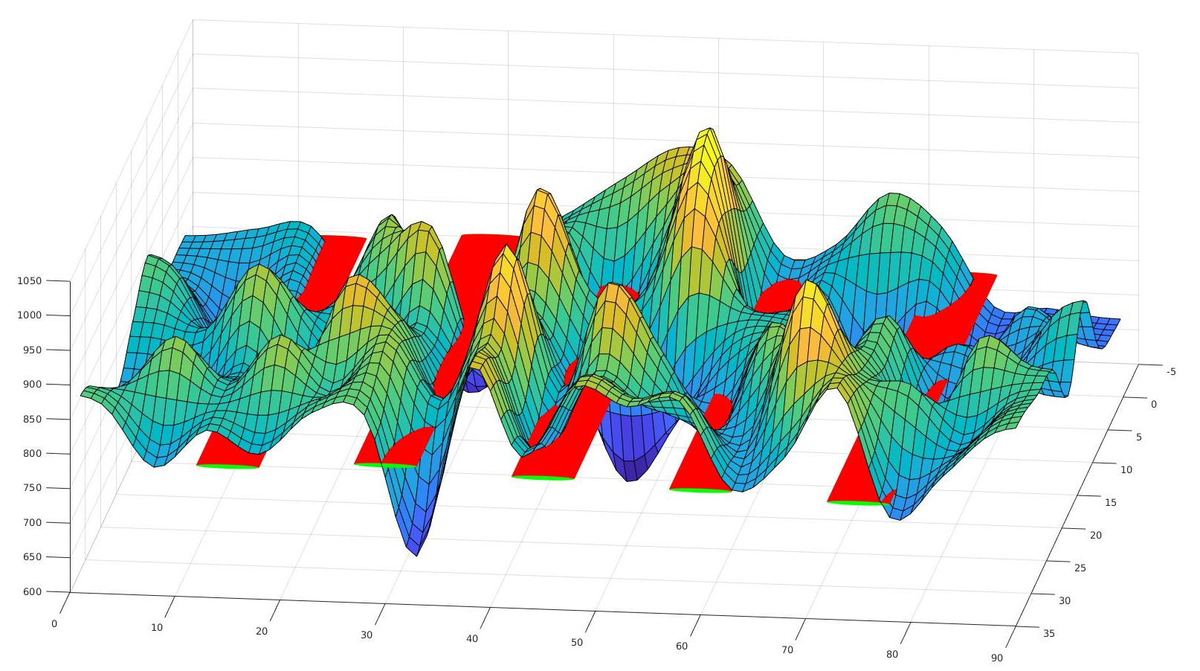
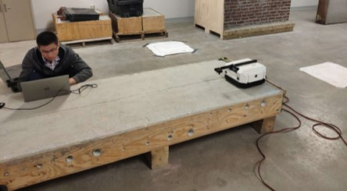
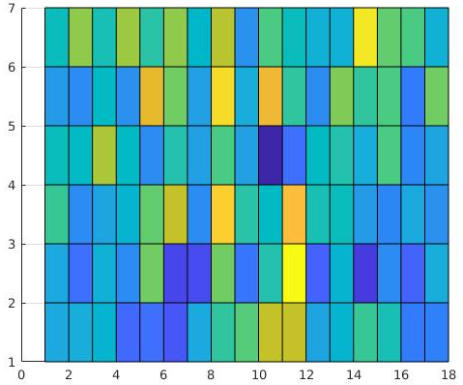
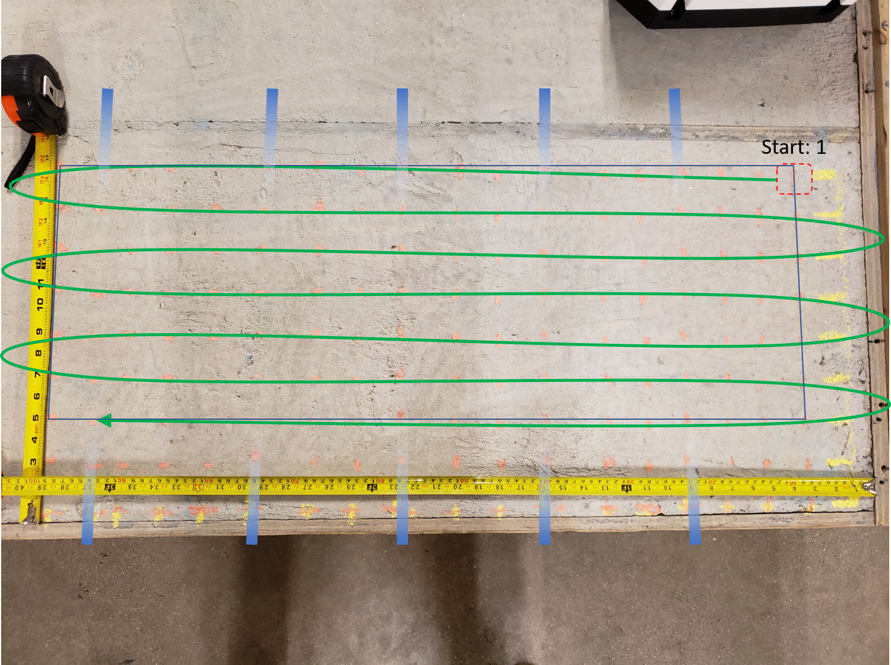
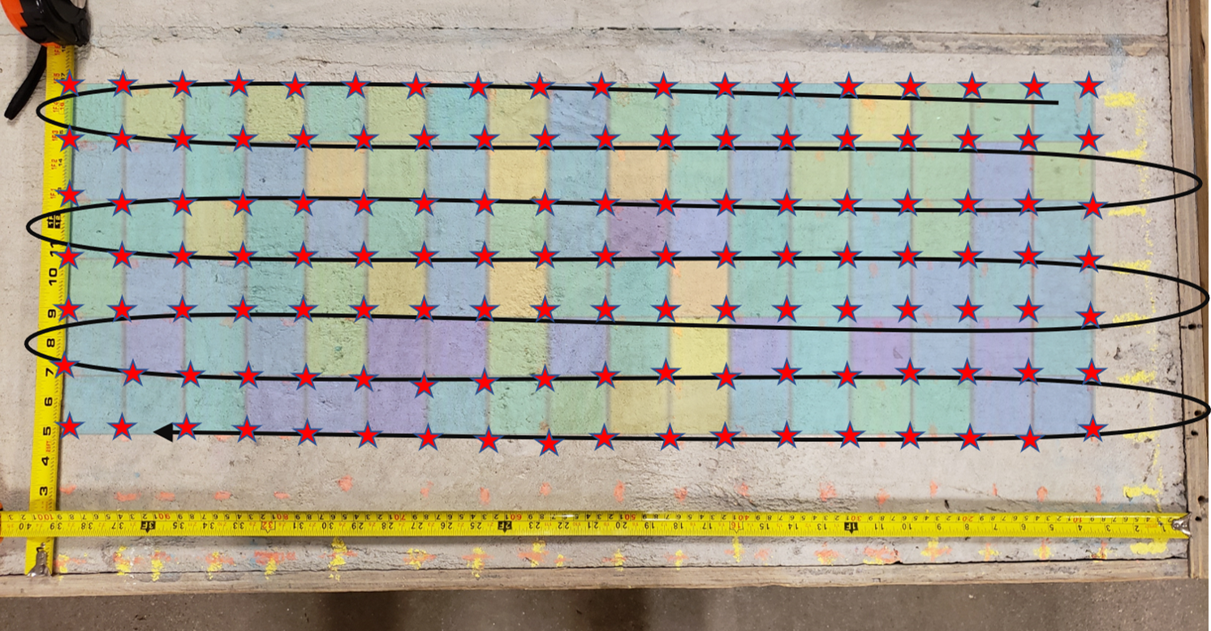
Automatic Impact-sounding Acoustic Inspection
of Concrete Structure
Jinglun Feng, Ejup Hoxha, Jizhong Xiao City College of New York
INTRODUCTION
Impact sounding signal has been shown containing information about the flaws of structural integrity and subsurface objects from previous researches. As a non-destructive testing (NDT) method, one of the biggest challenges in impact-sounding based inspection is the subsurface targets detection and reconstruction.
In order to address this issue, we implement a robotic solution to obtain the positioning information during the inspection. By combine thing pose data and acoustic data, we approach a 3D map to highlight the possible subsurface objects. The experimental results demonstrate the feasibility of the method.
RESULTS
The FFT frequency analysis result over the signal of interest is illustrated in the following. We could find that the energy of the source will be absorbed caused by a echo sounding at the area have the pipes.
Finally, we depict our FD analysis in 3D format. Noticed that we also add the pipes information as the ground truth in order to show the feasibility of our proposed method.
Since for those areas which have a pipe inserted would absorb the energy, from the 3D FD map we could tell the pipes are located at the regions where have a relative low energy level.
Then we use PSD method to visualize the amplitude of the signal with cool and warm colors. Furthermore, we register this frequency density (FD) map into the slab with the data collection trajectory which we obtained from tracking system.
Noticed that each star in the following registration map demonstrates the position information of impact-sounding test.
METHODS
Our proposed robotic inspection system consists of three parts:
Visual Pose Tracking System
Our tracking system takes advantages of Visual Inertial SLAM, an RGB-D camera provide us a robust 6-DOF position and orientation information on-the-fly at 30Hz rate.
The positioning accuracy could reach to 2cm which would meet the requirement of the Inspection System
Acoustic Inspection System
In order to reveal subsurface flaws in an automatic way, the impact sounding system is designed. This system includes solenoid which is used to provide the impacting action as well as microphone which is used to receive the echo sound.
We provide two modes to operate impact sounding module:
manual mode, that is, the operator choose the location to collect acoustic measurement through the Android controller.
automated acoustic inspection mode, that is, we set the system to trigger the solenoid and the microphone at 0.5 HZ rate.
Data Analysis System
The impact sounding signal is firstly processed by Fast Fourier Transform (FFT) and then analyzed with Power Spectral Density (PSD) method.
CONCLUSIONS
This poster introduces an autonomous impact-sounding inspection system that is able to create a comprehensive representation of the subsurface inspection results. First, this system implements visual inertial fusion to estimate the pose of the solenoid. Then, based on the features extracted from the impact-sounding signal FD, an improved acoustic inspection and 3D registration method was implemented to perform the classification and target re-localization. The experiments show the effectiveness of our proposed 3D subsurface objects reconstruction methodology.
MAIN REFERENCE
J. Xiao, “Toward autonomous wall-climbing robots for inspection ofconcrete bridges and tunnels,” 2018.
L. Yang ́ı, G. Yang, Z. Liu, Y. Chang, B. Jiang, Y. Awad, and J. Xiao,“Wall-climbing robot for visual and gpr inspection,” in2018 13th IEEEConference on Industrial Electronics and Applications (ICIEA). IEEE,2018, pp. 1004–1009.

